Slide 1
Distributed Applications

Slide 2
Role of Load Balancer
Modern websites serve millions of concurrent requests from users.
Need to return data in fast and reliable manner.
Load balancer efficiently distributes incoming network traffic.
Balance traffic across group of backend servers or multiple individual servers.
Avoid overload on any single server.

Slide 3
Load Balancer Functions
Distribute user request or network load efficiently across multiple servers.
Reduce the workload on an individual server.
Redirect traffic to servers which are up and running,
Ensuring high availability and reliability.
Provide scalability for applications without affecting the performance.

Slide 4
Load Balancing Parameters
Load balancer chooses server to forward the request to based on :
Health check
Load balancing algorithms
Health checks regularly attempt to connect to backend servers using the protocol and port to ensure servers are listening.
Algorithm decides healthy servers to be selected.
Load balancers implemented using software/hardware.

Slide 5
Load Balancing Algorithms
Round Robin
Least Connections
Source IP Hash
Weighted Scheduling
Least traffic

Slide 6
Software Load Balancers
Software load balancers implement combination of one or more scheduling algorithms.
Installed on the servers and consume the processor and memory of the servers.
Widely used scheduling algorithms:
Round Robin Scheduling
Least Connection First Scheduling
Weighted Scheduling Algorithm

Slide 7
Software Load Balancers
Weighted Scheduling Algorithm
Weight assigned to each server.
Work distributed across servers based on weight.
Algorithm used when there is considerable difference between capabilities and specification of servers in the cluster.

Slide 8
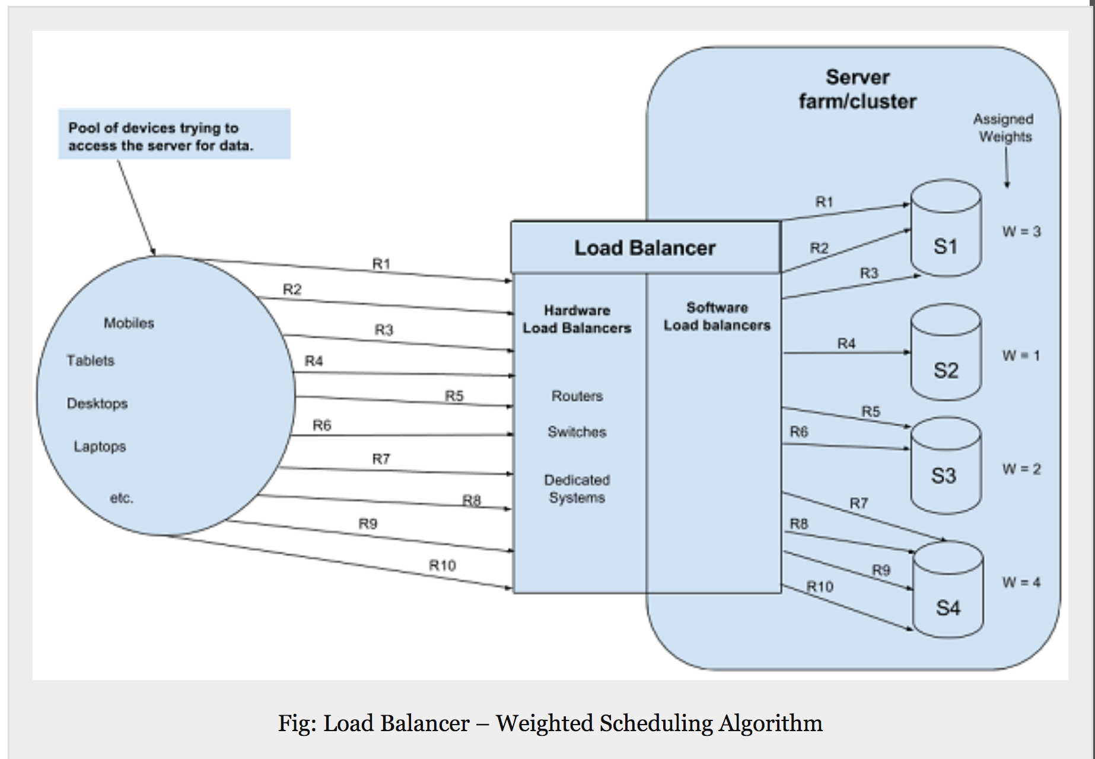

Slide 9
Round Robin Scheduling
Algorithm redirects requests in circular pattern to each node of load balancer.
Round Robin a good choice if servers comparable in size and RAM.
Requests distributed and served sequentially one after another.
Least Connection First Scheduling
Algorithm redirects traffic to server with least persistent connections.
Algorithm works best if servers have similar capabilities.

Slide 10
Software Load Balancer Examples
HAProxy – A TCP load balancer.
NGINX – A http load balancer with SSL termination support.
Mod_athena– Apache based http load balancer.
Varnish – A reverse proxy based load balancer.
Balance – Open source TCP load balancer.
LVS – Linux virtual server offering layer 4 load balancing.

Slide 11
Hardware Load Balancer
Hardware are specialized routers or switches which are deployed in between servers and client.
Dedicated system in between client and server.
Implemented at multiple layers in OSI Model.
Transport Layer (Layer 4)
Application Layer (Layer 7)

Slide 12
Layer 4 Hardware Load Balancing
Implemented on transport layer.
Visibility on network information.
Application ports and transport layer protocols (TCP,UDP and SCTP).
Combine network information with load balancing algorithm to decide best destination server.

Slide 13
Layer 7 Hardware Load Balancing
Implementation on application layer allows visibility on actual content of messages (URL, cookies, scripts, type of data).
Additional information enable more complex load balancing decisions.
Popular techniques:
URL parsing to know about different type of contents.
Cookie sniffing for a session aware routing.
HTTP reading to look for http header information.

Slide 14
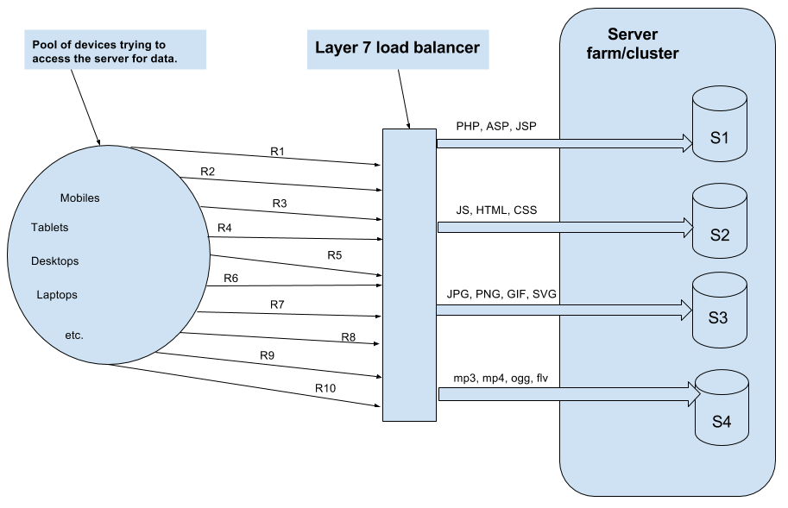

Slide 15
Hardware Load Balancer Examples
F5BIG_IP load balancer.
CISCO system catalyst.
Barracuda load balancer.
Coyote point load balancer.

